Slide 1

UNIT - V
Artificial Intelligence
1

Slide 2
1. Phases in building Expert Systems
Building Expert System (ES) requires extracting the knowledge from a human domain expert
This extracted knowledge should be represented
This phase is said to be ‘Knowledge Acquisition’ and this is knowledge engineering
Following are the phases of building ES:
Identification phase
Conceptualization phase
Formalization phase
Implementation phase
Testing phase
2

Slide 3
Identification phase:
Knowledge engineer determines the important features of the problem with the help of human domain expert
The parameters (determined in this phase) include the scope, resources required, and the goal of ES
Conceptualization phase:
Knowledge engineer and domain expert decide the concepts, relations, and control mechanism needed to describe problem solving method
In this, issue of granularity is also addressed, which
refers to the level of details required in the knowledge
3

Slide 4
Formalization phase:
This involves expressing the key concepts and relations in
some framework supported by ES building tools
Formalized knowledge contains DS, inference rules, control strategies, and languages required
Implementation phase:
Formalized knowledge is converted to a working computer
program, called prototype of the system
Testing phase:
Evaluating the performance and revising the system
Domain experts provide feedback
4

Slide 5
1.1. Knowledge Engineering
The whole process of building an ES is referred to as Knowledge Engineering
It involves ES builder, or the knowledge engineer, domain experts, and potential users
Responsibilities of a knowledge engineer are:
To ensure the computer has all the knowledge needed to solve a problem
Choosing one or more forms to represent the required knowledge
To ensure the computer can use the knowledge efficiently by selecting some of the reasoning methods
5

Slide 6



Queries
Strategies & domain rules
Expert system
Domain expert
Knowledge engineer
Solutions
Interaction between Knowledge engineer and Domain Expert for creating an EX
Role of knowledge engineer(KE) begins once the problem for developing an ES is decided
KE interviews the domain expert to extract general rules and ensures their correctness from expert
Then KE translates the knowledge into a computer program and design an interface
6

Slide 7
1.2. Knowledge Representation
The power of ES is its high quality knowledge
Domain knowledge is knowledge base & problem solving knowledge is inference engine
Most common KR scheme for ES consists of production rules or simply rules (if-then-else)
ES in which knowledge is represented in the form of rules is known as Rule-based ES
If rules have some uncertainty; Statistical techniques are
used to handle such rules
7

Slide 8
Another widely used representation in ES is unit (also known as frame, semantic net, etc.)
Unit is an assemblage of associated symbolic knowledge about an entity to be represented
Unit consists of properties and values of entity
Values of properties represent the names of other units that are linked as per the relations
Future of ES depends on developing better methods of:
Knowledge acquisition and in codifying
Representing a large knowledge infrastructure

Slide 9
2. Expert System Architecture
User interacts with ES through an interface which may have
menus, natural language or any other style of interaction
An inference engine is used to reason with expert knowledge
as well as the data specific to the problem being solved
Case specific data will be included in working memory
Systems also have knowledge acquisition module that helps the expert or knowledge engineer to easily update and check the knowledge base

Slide 10
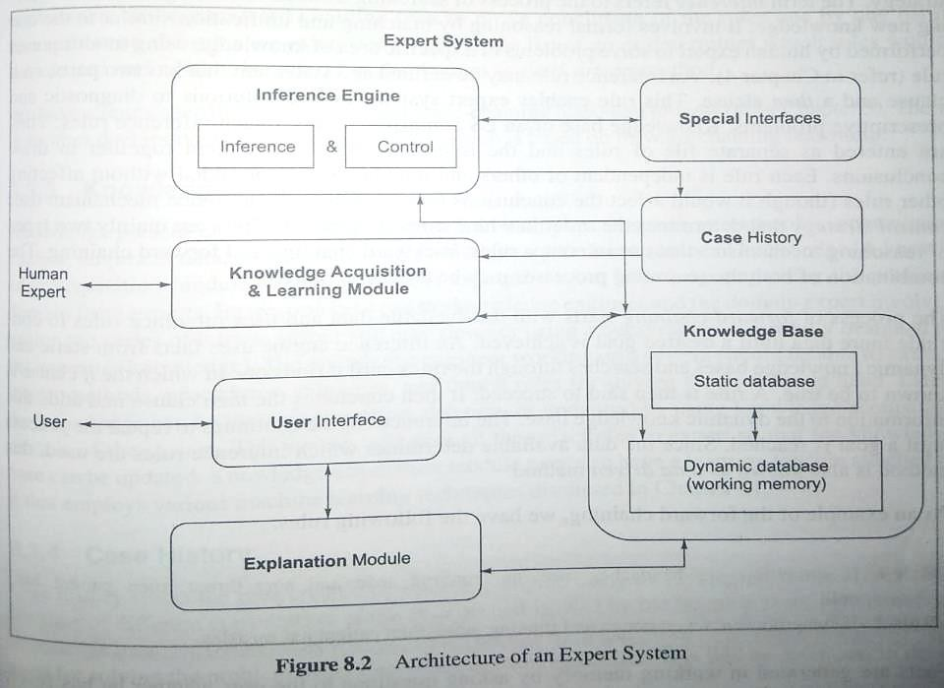

Slide 11
Knowledge base:
Consists knowledge of a problem domain in the form of static and dynamic databases
Static knowledge contains rules and facts and other types and does not change during the execution
Dynamic knowledge consists of facts related to a particular consultation of the system
At the beginning of the consultation, dynamic knowledge base is empty and grows as the consultation progresses
Used in decision making along with static knowledge
Working memory is deleted at the end of consultation

Slide 12
Inference engine:
Consists inference mechanisms and control strategy
Inference refers the process of searching through knowledge base and derives new knowledge
It use Modus Ponen’s rules, if-then-else rule, etc.
inference mechanism uses control strategy that determines the order in which rules are applied
Rules are entered as a file and the inference engine uses them together to draw conclusions
It uses two types of reasoning mechanisms viz., Backward chaining and forward chaining

Slide 13
Knowledge acquisition:
It may be done from many resources like books, reports, case studies, empirical data, domain expert, etc.
Knowledge can be updated (insert, delete, update)
This module may also have a learning module attached to various Machine Learning techniques
Case history:
Stores the files created by inference engine using dynamic DB and is used by the learning module
It enriches the knowledge base

Slide 14
User interfaces:
Allows user to interact with the ES and creates working knowledge for the problem to be solved
Presents questions and information and forwards the responses of the user to inference engine
Validates the answers of user as per the rules
Questions are generated as per the information present in the system and knowledge contained in knowledge base

Slide 15
Explanation module:
Enables to query the ES about why it asked some question and how it reached some conclusion
These modules are called how and why modules
How module tells uses regarding the process through which the system has given a solution
Why module tells the users that the reasoning behind the solution
Special interfaces:
Used for specialized activities
Used for uncertain and incomplete knowledge

Slide 16
3. ES vs Traditional Systems
Basic difference is ES manipulates knowledge where as TS manipulates data
Ess allows the use of confidences or certainty factors, which is similar to human reasoning
E.g. if weather is humid, then it might rain probably.
– It contains: if, then, might, probably, etc. which indicates uncertainty
This type of reasoning can be imitated by using numeric values called confidences

Slide 17
E.g. if the weather is humid, it might be concluded with 0.9 confidences that it rains
They are meant to imitate the confidences humans use in reasoning rather than to follow the mathematical definitions
TSs are designed to produce always correct answers, whereas ES designed to behave like human
Ess may sometimes give incorrect results

Slide 18
3.1. Characteristics of ES
Expertise: have high level of skill and robustness
Symbolic reasoning: knowledge is represented symbolically which can be easily reasoned
Self knowledge: a system should be able to explain and examine its own reasoning
Learning capability: a system should learn from its mistakes and improves as it grows
Ability to provide training: is capable of provide training by explaining the reasoning process
Predictive modelling power: it can explain how
new situation led to change
18

Slide 19
3.2. Evaluation of ES
Consists of performance and utility evaluations
Performance evaluation consists of answering various questions such as:
Does the system make decisions that experts generally agree to?
Are the inference rules correct and complete?
Does the control strategy allow the system to consider items in the natural order that the expert prefers?
Are relevant questions asked to the user in proper order?
Are the explanation given by the ES adequate for describing How and Why conclusions?

Slide 20
Utility evaluation consists of answering the questions such as:
Does the system help user in a significant way?
Are the conclusions of the system organized and ordered in a meaningful way?
Is the system fast enough to satisfy the user?
Is the user interface friendly enough?

Slide 21
3.3. Advantages & disadvantages of ES
Advantages:
Provides consistent answers for repetitive decisions, processes, and tasks
Fastens the pace of human professional work
Holds and maintains significant levels of info
Provides improved quality of decision making
Domain experts are not always able to explain their logic and reasoning unlike ES
Leads to major internal cost savings in companies
Causes introduction of new products
Never forgets to ask a question

Slide 22
Disadvantages:
Unable to make creative responses as human experts in unusual circumstances
Lacks common sense needed in some decision making
May cause errors in the knowledge base, and lead to wrong decisions
Cannot adopt to changing environments, unless knowledge abase in changed

Slide 23
4. Rule based ES
Expert system shell in prolog
Here we will develop a simple expert system
We define a special syntax for the rules using operator declarations (:-op)
Using op, any standard system operator declaration can be changed or new operator can be defined by the user
A goal op with three arguments:
:- op (Prec, Type, Atom)

Slide 24
Prec is an unsigned integer in the range [1,1200]
Type Є {fx, fy, xfx, xfy, yfx, yfy} is a specification representing associativity
Atom is a symbol or a name declared as an operator with precedence Prec and Type
For declaring infix operators, Type are xfx, xfy, yfx, yfy, here f - an operator and x & y are arguments
The choice of x & y in the positions mentioned above convey associativity information
x means the operator in the argument must have strictly lower precedence value of operator f
y means the argument can contain operator with the same/lower precedence value than operator f

Slide 25
5. Blackboard Systems
Combining diverse s/w modules as per their data-flow requirements is a traditional way
This approach works well when communication among the modules is static
In dynamic environment, specific modules and their ordering will be changed
Hence cannot be determined until specific data values are known at the time of execution
Direct interaction induces inflexibility and the system becomes unusable

Slide 26
Hence, indirect and anonymous communication among modules with the help of blackboard data repository proves to be extremely useful
Blackboard data repository is an intermediary process, in which all processing paths are possible
A separate moderator mechanism dynamically selects a path among all possible paths
The information placed on the blackboard is public and is made available to all modules
BB systems are developed to solve complex, difficult and ill-structured problems in a wide range of application areas
26

Slide 27





Blackboard
Control
KS1
KS2
KS3
KS4
KS5
Indirect and anonymous communication

Slide 28


Blackboard architecture represents controlling the knowledge bases, using independent groups of rules, called Knowledge Sources (KSs)
BBS consists the following components:
Knowledge sources
Blackboard
Blackboard
– Control shell
Control shell
Knowledge Sources

Slide 29
Knowledge Sources (KSs):
BB uses a functional modularization of expertise knowledge in the form of KSs
These are independent computational modules that contain expert knowledge to solve a problem
These are diverse in their internal representation and
computational techniques
Do not interact directly with each other
KSs can be added, updated and deleted
Each KS is aware of the conditions under which it can contribute to solve problem
This awareness is known as triggering condition

Slide 30
Blackboard:
It is a global data repository and shared DS available to all KSs
It contains raw input data, partial /final solutions, alternatives, control info, communication medium, buffer and a KS trigger mechanism
If the no.of contributions placing on the BB is large, it creates problems in locating the required info
This issue is solved by sub-dividing the BB in to regions; and each region links with a particular info
Important characteristic of BB is to integrate the contributions dynamically
It can retain the results of the problems that were solved earlier

Slide 31
Control component:
It helps in making runtime decisions about the problem solving and the expenditure of the problem-solving resources
It is also called control shell sometimes
BBS uses the process of incremental reasoning
Solution to the problem is built one step at a time
In BBS, currently executing KS activation (KSA) generates events as it makes changes on BB
These events are ranked, best KSA is selected for execution
KS execution cycle continues until the problem is solved

Slide 32
Blackboard
Execution of KS
Activation
KSs
Events
Best KSA
KS Activation (KSA)
New KSA
Control Shell
Blackboard-System Control Cycle

Slide 33
6. Truth Maintenance Systems
Also known as Reason Maintenance System
TMS maintains the belief for general problem solving systems
Inference engine explores alternatives, makes choices, and examines their consequences
If a contradiction is noticed during this process, the TMS eliminates it by revising the KB
TMSs work with inference engines for solving problems within large search spaces
Inference engine & TMS together can solve problems in which algorithmic solutions do not exist

Slide 34
6.1. Monotonic System and Logic
Axioms are not allowed to change, once a fact is confirmed to be true
It must always remain true and can never be modified
All the axioms used are either basic or derived from other facts that are also known to be true
Making assumptions, such as probably, likely, etc. are not allowed

Slide 35
Def: if a formula is a theorem, for a formal theory, then the formula remains a theorem for any augmented theory obtained by adding axioms to the theory
– E.g. if a property P is a theorem of T and if T is augmented to T1 by additional axioms, then P remains a theorem of T1
If an axiom A is added to a theory T to build a theory T1, then all of the theorems of T are also theorems of T1
In monotonic reasoning, the world of axioms continually increases in size and keeps on expanding

Slide 36
6.2. Non-Monotonic System and Logic
Truths that are present in the system can be retracted whenever contradiction arise
Hence, number of axioms can increase as well as decrease
The system is continually updated depending on the knowledge base
In non-monotonic logic, formula of a theorem for a formal theory, need not be a theorem for an augmented theory

Slide 37


Common sense reasoning is an example of non-monotonic reasoning
Non-monotonic reasoning is based on inferences made by applying N-M logic
Monotonic and non-monotonic reasoning can be best implemented using TMS
IE TMS
Problem Solver
KB
Interaction b/w different components in a Problem Solver
37

